Slide 1
The ChapR
Add the kawaii pic from the website

Slide 2
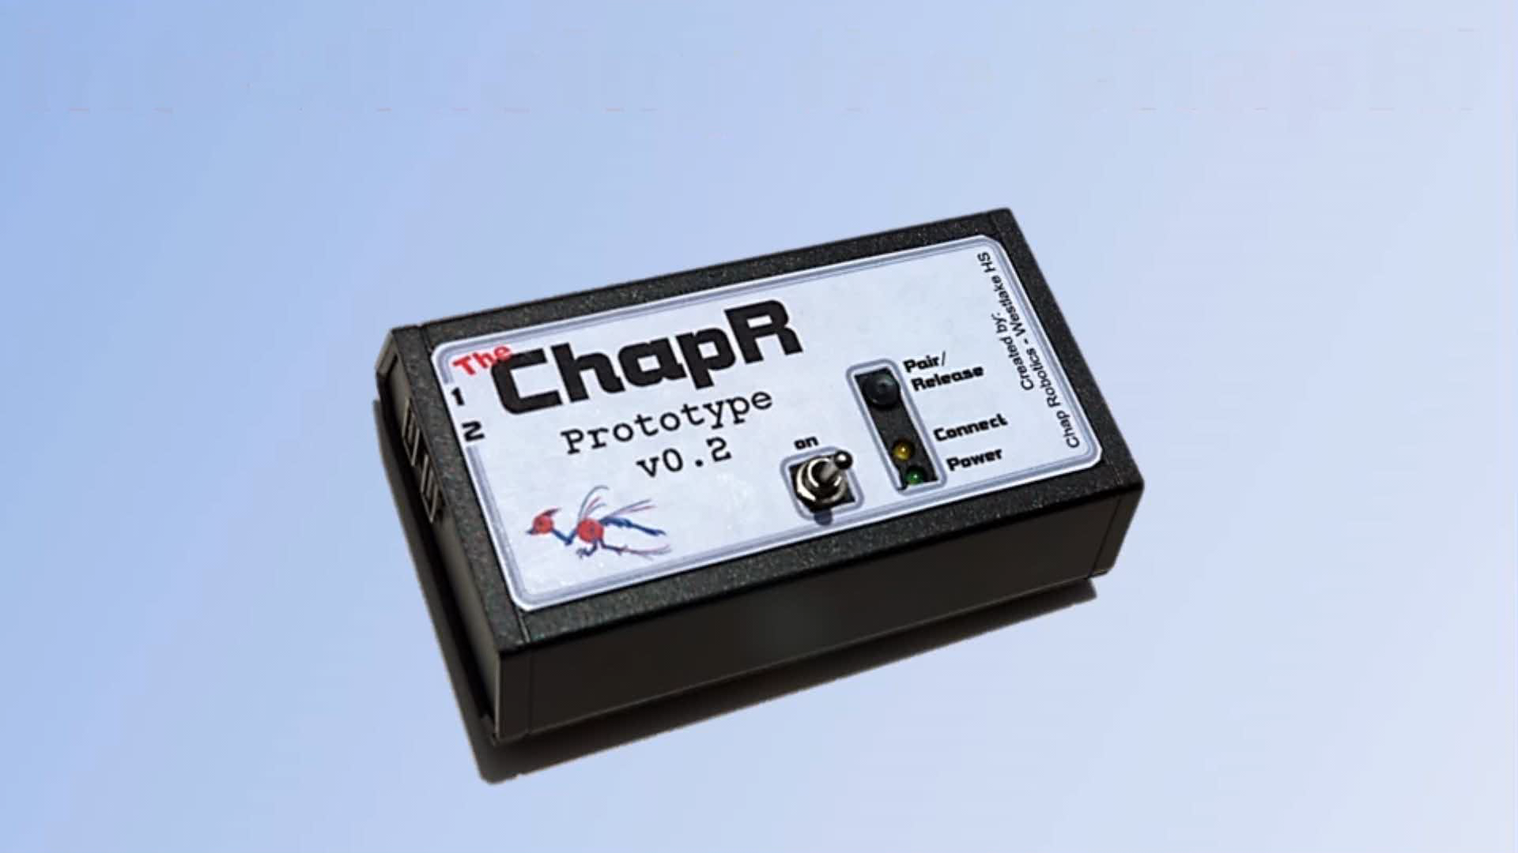

Slide 3
Features/Demo

Slide 4
Regular Use

Slide 5
Configurable
Name
Timeout
Personality
Mode
Lag

Slide 6
Programmable

Slide 7
The Hardware

Slide 8
The Software

Slide 9
Moving Forward

